Slide 1
STRESS MANAGEMENT
Presented By:
Dr. Sushama Sharma
Email - sushamasharma61@gmail.com
Mob.: 98930-30113

Slide 2
Agenda
What is Stress
Causes of stress
Types of stress
How it affects our daily life
Identifying our individual stressors
Checking our vulnerability to stress in different situations
Techniques to control stress
Conclusion

Slide 3
What is Stress ?
Stress can be defined as our mental, physical, emotional and behavioral reactions to any perceived demands or threats.

Slide 4
Basic Concepts About Stress
Stress is defined as how the body reacts to demands.
Stressors are causes of stress.
Stress is part of our lives.
It is not possible to live stress-free.
Managing stress in positive ways prepares us for increasing life challenges.

Slide 5
What Causes Stress ?

Slide 6
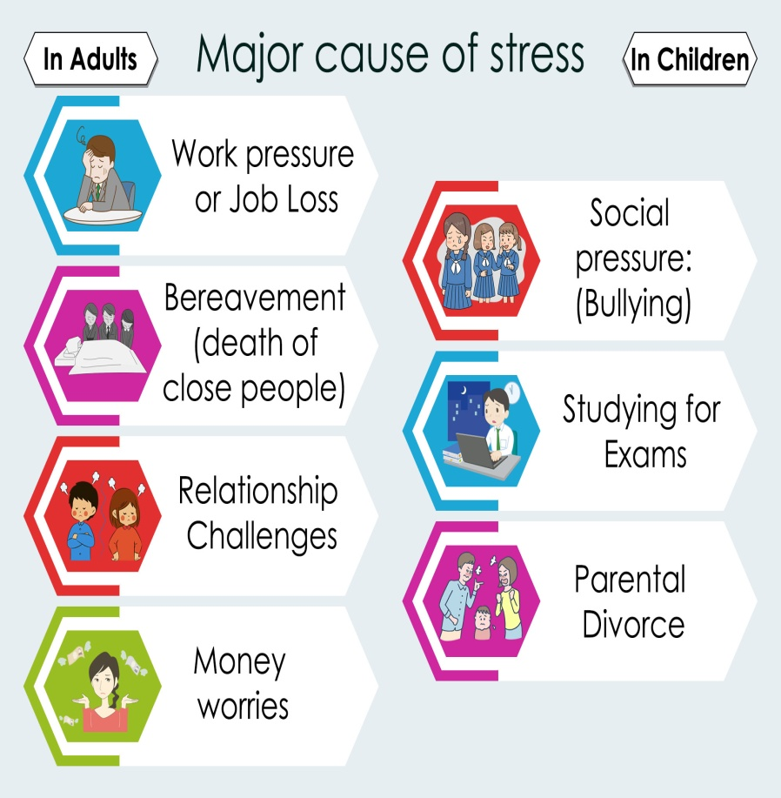
Causes of Stress
Internal Causes
External Causes
Chronic worry
Major life changes
Pessimism
Work or college
Rigid thinking
Broken Relationships
Negative self talk
Financial problems
Unrealistic expectations
Stress in your family
All or nothing attitude
Being too busy

Slide 7
Types of Stress

Slide 8
Symptom’s of Stress :
Physical Behavioral Emotional
Fatigue Disturbed Sleep Tired
Chest Pain Not Attentending class Worried
Headaches Procustination Irritable
Upset Stomach Increase Alcohol Frustrated
Muscle Tension Increase Coffin Confused
Rapid Heart Rate Distractibility Disoriented

Slide 9
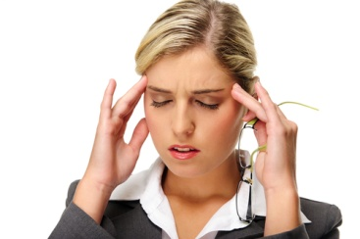
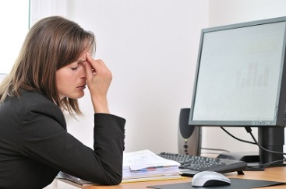
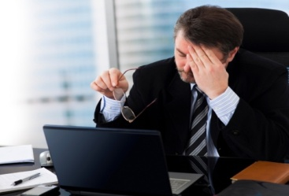
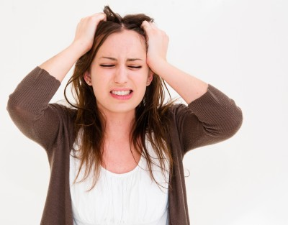
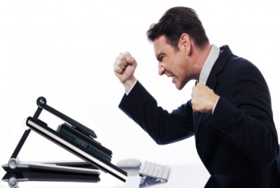
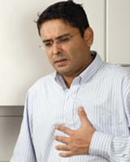
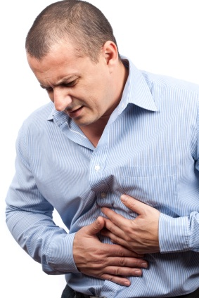
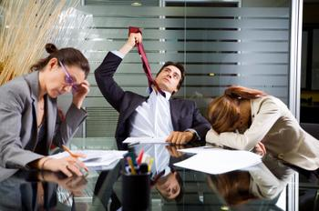
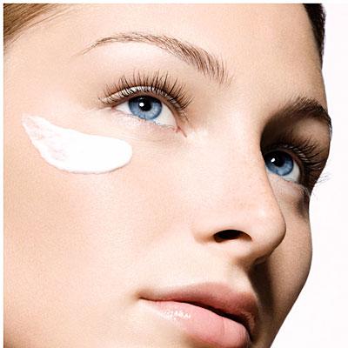
Signs and Symptoms of Stress
1. Headache
2. Fatigue
3. Poor Concentration
4.Irritability
5. Aggression
6. Palpitation
7. Indigestion
8. Overreacting
9.Underreacting
10. Skin Problem

Slide 10
Effects of Stress

Slide 11
Physical Effects of Stress
Headache
Sleepiness
Tight or sore muscles
Shaky hands
Sweetness
Stomach ache
Rapid breathing

Slide 12
Emotional Effects of Stress
Moodiness
Lack of enthusiasm
Forgetfulness
Excessive worry
Short tempered
Feeling overwhelmed

Slide 13
Effects of Stress on Health
Depression and Anxiety
Weight problems
Heart diseases
Digestive problems
Cognitive and Memory problems
Skin problems life eczema

Slide 14
Cycle of Stress

Slide 15
About People and Stress

Slide 16
Individual Stressors
Work
Roommate
Legal matters
Classes
Childcare
Mental Health
Studying
Finances
Law violation
Relationship with partner
Appearance
Spiritual/Religious issues
Relationship with family
Physical Health
Major/Career decisions
Relationship with friends
Not “Fitting in”
Attitudes/thoughts
Trauma
Getting married
Buying a house
Change in residence
Change to a new school
Change in amount of recreation
Change in amount of social activities
Change in eating habits
Death of friend/family member

Slide 17
Vulnerability to Stress

Slide 18
Vulnerability Test – Let us check
 | Almost Always | Usually | Sometimes | Almost Never | Never
1. I eat at least one hot, balanced meal a day.
2. I get 7-8 hours of sleep, at least 4 nights a week.
3. I give and receive affection regularly.
4. I have at least 1 relative within 50 miles on whom I can rely.
5. I exercise to the point of perspiration at least twice a week.
6. I smoke less that half a pack of cigarettes a day (non-smokers = almost always.)
7. I drink fewer than 5 alcoholic drinks a week. (non-drinkers = almost always).
8. I am the appropriate to meet my height.
9. I have an income adequate to meet my basic needs.
10. I get strength from my religious/spiritual beliefs.

Slide 19
Vulnerability Test – Let us check
 | Almost Always | Usually | Sometimes | Almost Never | Never
11. I regularly attends club or social activities.
12. I have a network of friends and acquaintances.
13. I have at least 1 friend in whom I confide about personal matters.
14. I am in good health (including eyesight, hearing, teeth etc.
15. I am able to speak openly about my feelings when angry or worried.
16. I have regular conversations with my housemates about domestic problems.
17. I do something fun at least once a week.
18. I am able to organize my time effectively.
19. I drink fewer than 3 caffeine drinks a day.
20. I take quiet time for myself during the day.
Calculate your score | 0 Points | 1 Point | 2 Points | 3 Points | 4 Points
Total Score :

Slide 20
What Your Score Means
Indicates you have excellent resistance to the vulnerability of stress
0 - 10
Little vulnerability to stress
11 - 29
Some vulnerability to stress
30 - 49
Serious vulnerability
50 - 74
Extreme vulnerability
75 - 80

Slide 21
Strategies
Stretch – Stand on your toes whenever you feel under pressure and stretch your body.
Laugh –as much as you can.
Take deep breathing.
Listen to music.
See the sunlight.
Discover the yogi in you. Do meditation.
Talk less listen more.
Count your blessing .
Compare with yourself and see the changes.
Do nothing sit out.
Express your stress.

Slide 22
Techniques to Handle Stress
Get moving
Connect to others
Set aside relaxation time
Eat a healthy diet
Get your rest

Slide 23
Conclusion

